Slide 1

CREDIT EDA CASE STUDY
Arshad Shaikh

Slide 2

About
This assignment aims to give you an idea of applying EDA in a real business scenario. In this assignment, apart from applying the techniques in the EDA, we will also develop a basic understanding of risk analytics in banking and financial services and understand how data is used to minimize the risk of losing money while lending to customers.

Slide 3

OBJECTIVE
OBJECTIVE
This case study aims to identify patterns which indicate if a client has difficulty paying their instalments which may be used for taking actions such as denying the loan, reducing the amount of loan, lending (to risky applicants) at a higher interest rate, etc. This will ensure that the consumers capable of repaying the loan are not rejected. Identification of such applicants using EDA is the aim of this case study.
In other words, the company wants to understand the driving factors (or driver variables) behind loan default, i.e. The variables which are strong indicators of default. The company can utilize this knowledge for its portfolio and risk assessment.
To develop your understanding of the domain, you are advised to independently research a little about risk analytics - understanding the types of variables and their significance should be enough.

Slide 4

SOLUTION
PROBLEM UNDERSTANDING
DATA SOURCING
Data cleaning
Univariate analysis
Multivariate analysis

Slide 5

Problem Understanding
When the company receives a loan application, the company has to decide for loan approval based on the applicant’s profile. Two types of risks are associated with the bank’s decision:
Approved
Cancelled
Refused
Unused offer

Slide 6
DATA SOURCING
The dataset source link was provide by the UpGrad.
https://drive.google.com/open?id=16RQztUqCfJOlbooHqYlJrp6Q7iL65uZB
This dataset has 3 files as explained below:
'application_data.csv' contains all the information of the client at the time of application. The data is about whether a client has payment difficulties.
'previous_application.csv' contains information about the client’s previous loan data. It contains the data on whether the previous application had been Approved, Cancelled, Refused or Unused offer.
'columns_description.csv' is data dictionary which describes the meaning of the variables.

Slide 7

DATA CLEANING

Slide 8

Cleaning process
Missing value
Datatype standardisation
Handling Outlier
We removed the columns with more than 40% of missing. And also imputed some with mode as they were categorical variable
We also looked at the data types of the variable which were wrongly characterised
We also imputed the outliers . We performed binning to categorize the data

Slide 9

UNIVARIATE AND MULTIVARIATE ANALYSIS

Slide 10
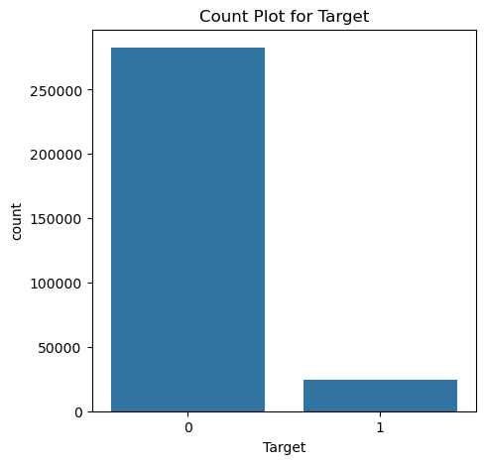
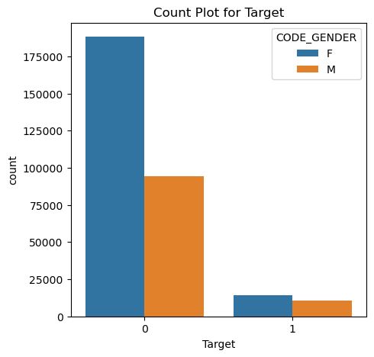
The Data is Imbalance with 90% of people did not faced any payment issues.
Females are the one who are most likely to reapply for the loan

Slide 11
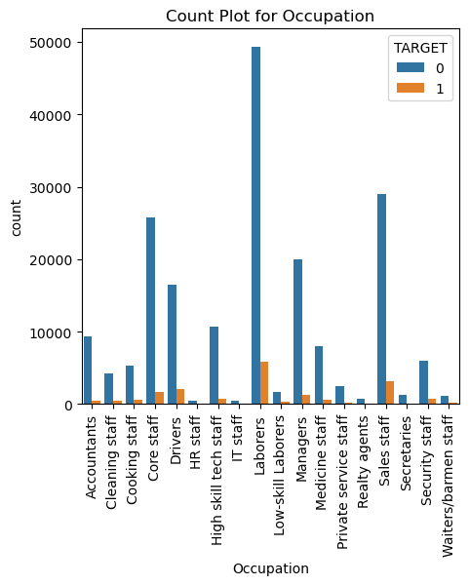
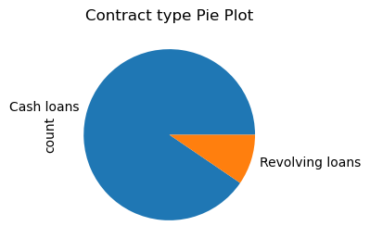
Most of the loan applicants are Laborers.
The applicants prefers to have cash loan instead of Revolving Loan

Slide 12
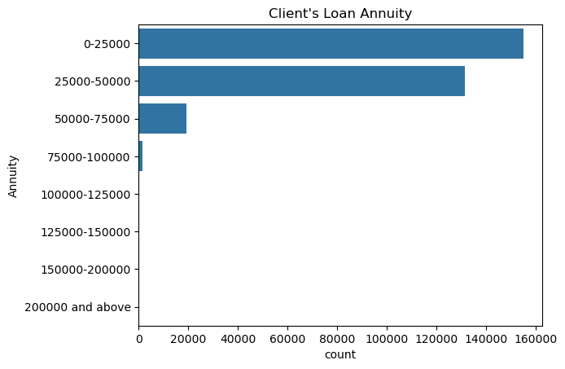
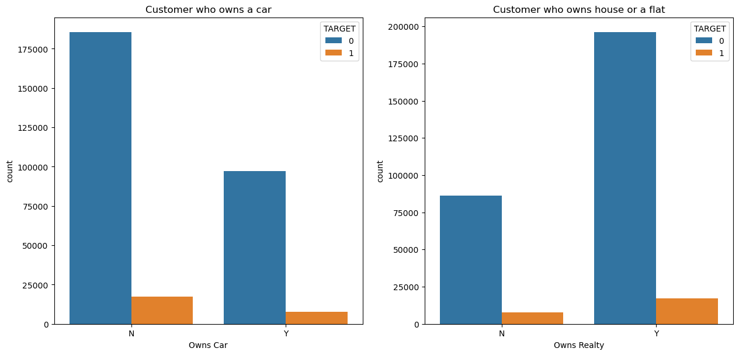
Most of the applicant owns house.
The clients Loan Annuity is <75000 for most of the applicants.

Slide 13
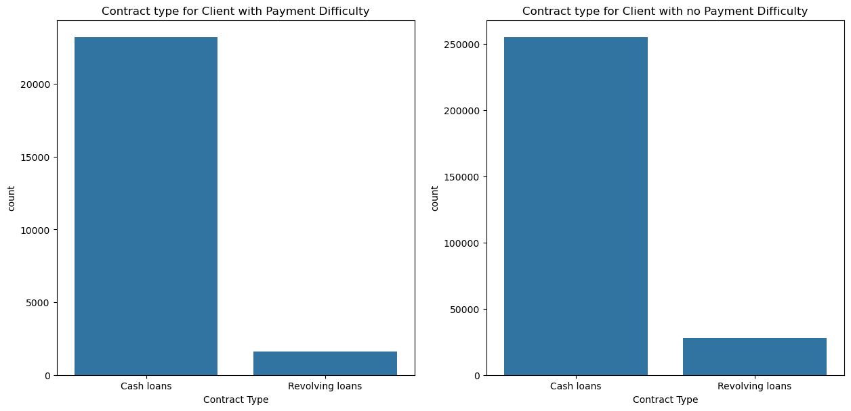
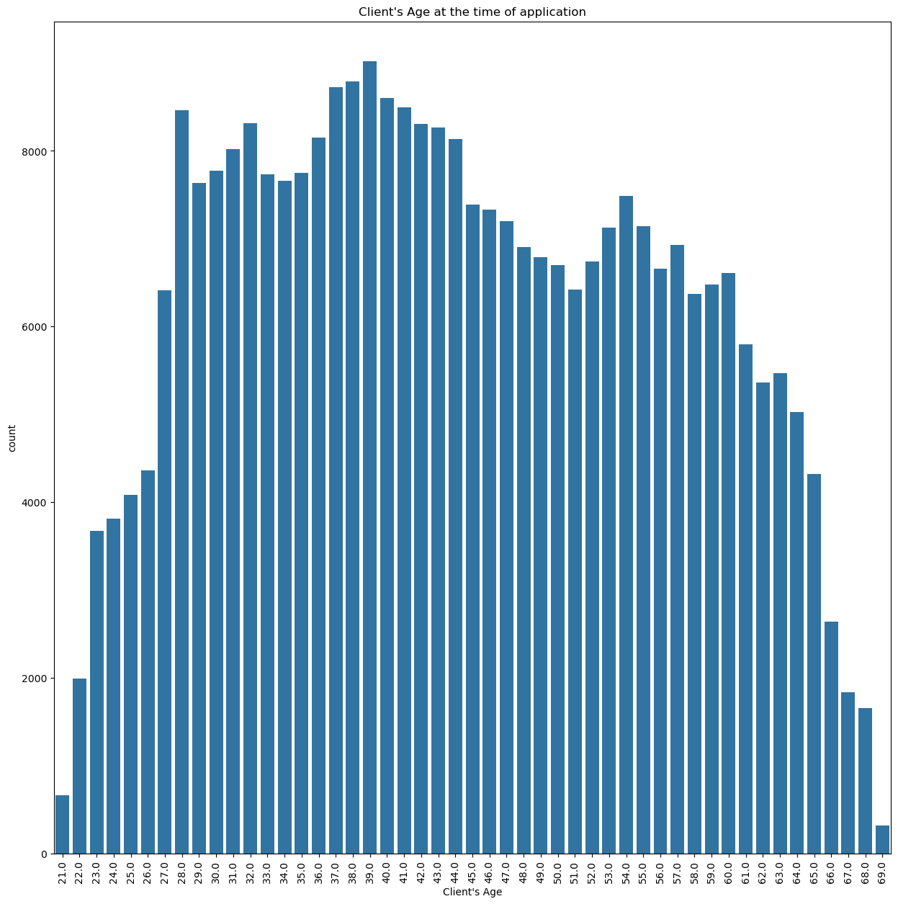
Most applicants are in age range 30 to 45.

Slide 14
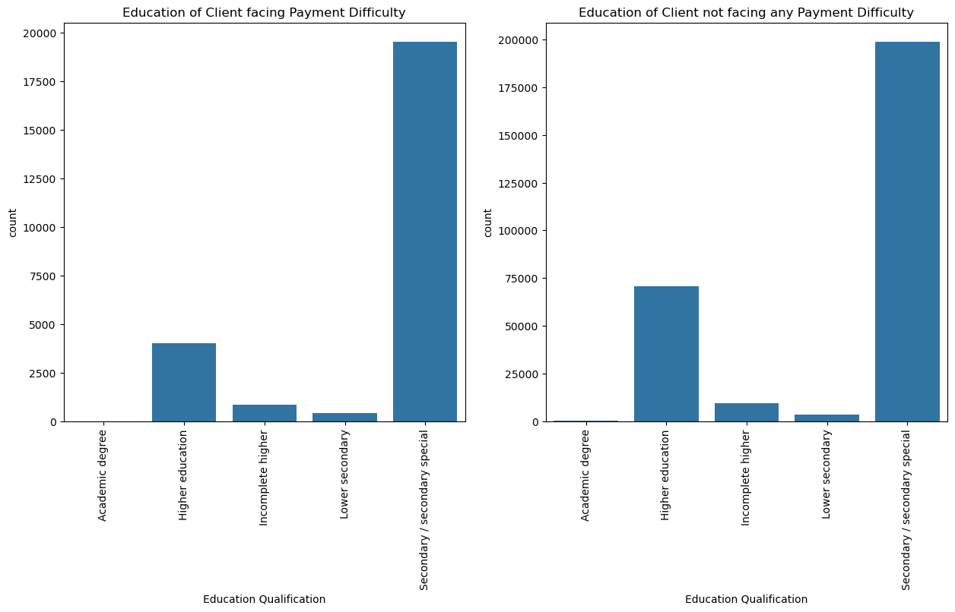
Most of the applicants have secondary Education

Slide 15
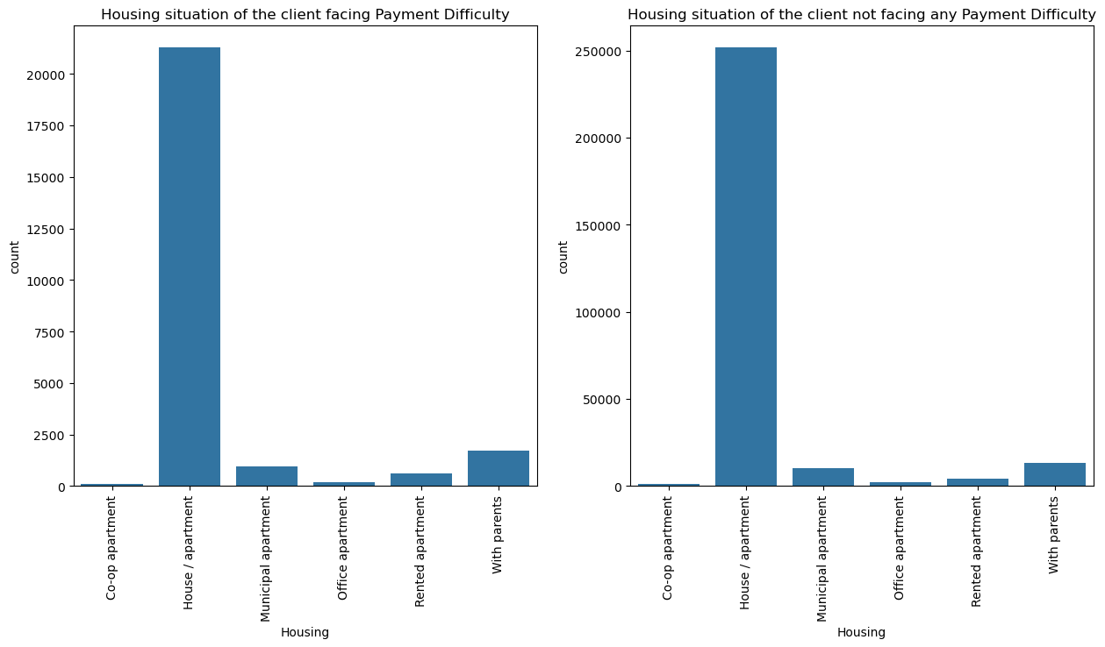
Most of the applicants stays in House/ Apartment.

Slide 16
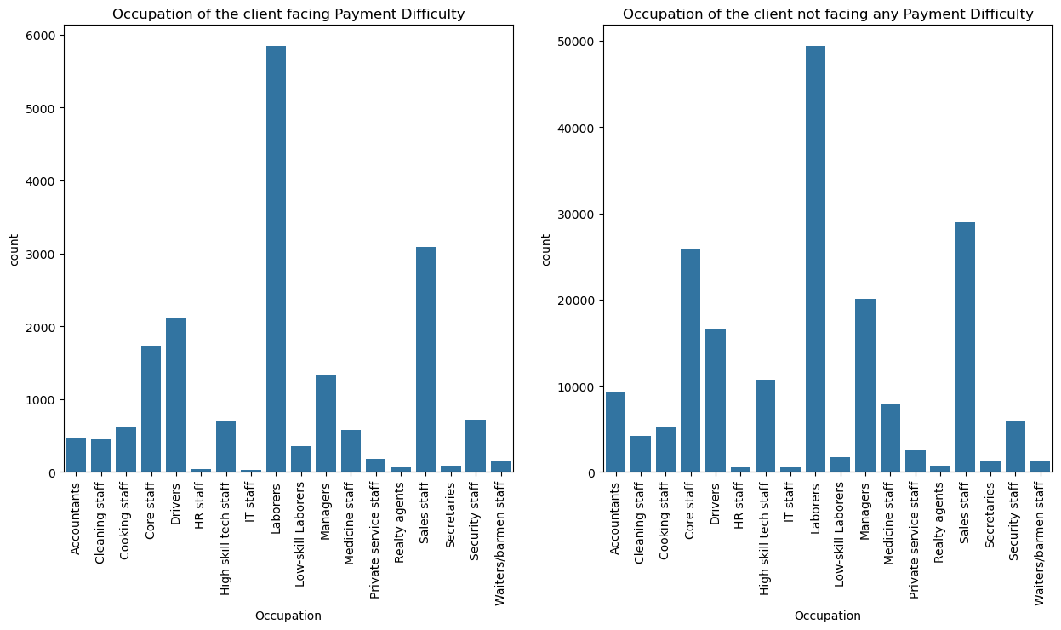

Slide 17
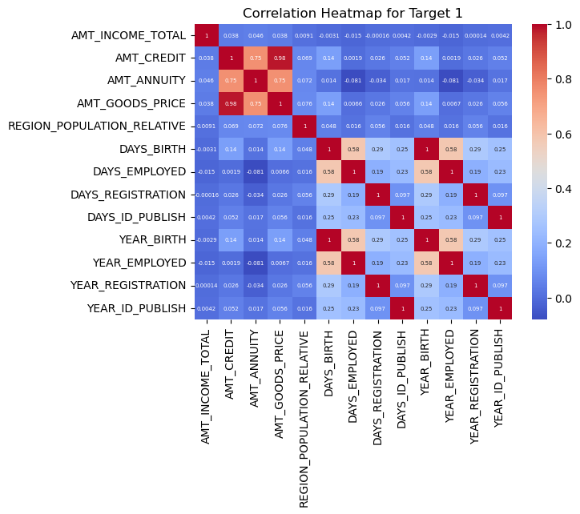

Slide 18
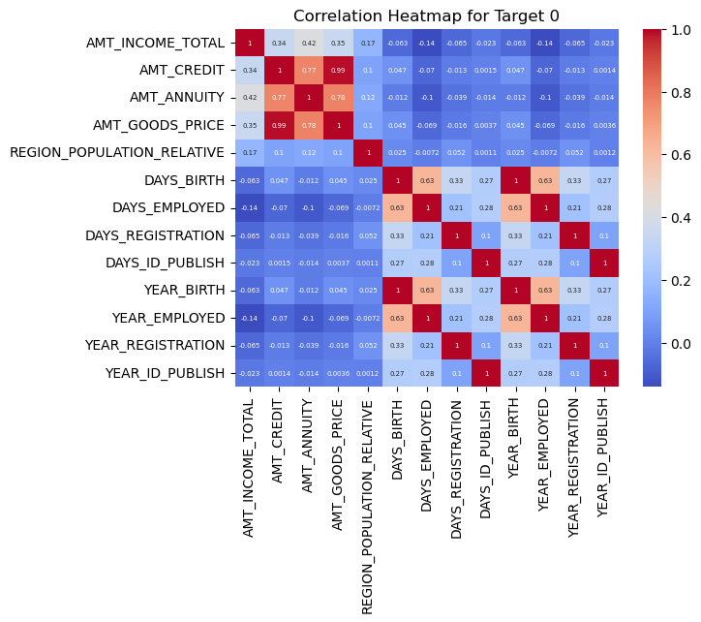
DAYS_EMPLOYED & YEAR_EMPLOYED, DAYS_BIRTH & YEAR_BIRTH, DAYS_REGISTRATION & YEAR_REGISTRATION, DAYS_ID_PUBLISH & YEAR_ID_PUBLISH, and AMT_CREDIT & AMT_GOODSPRICE are highly correlated in both the Target

Slide 19
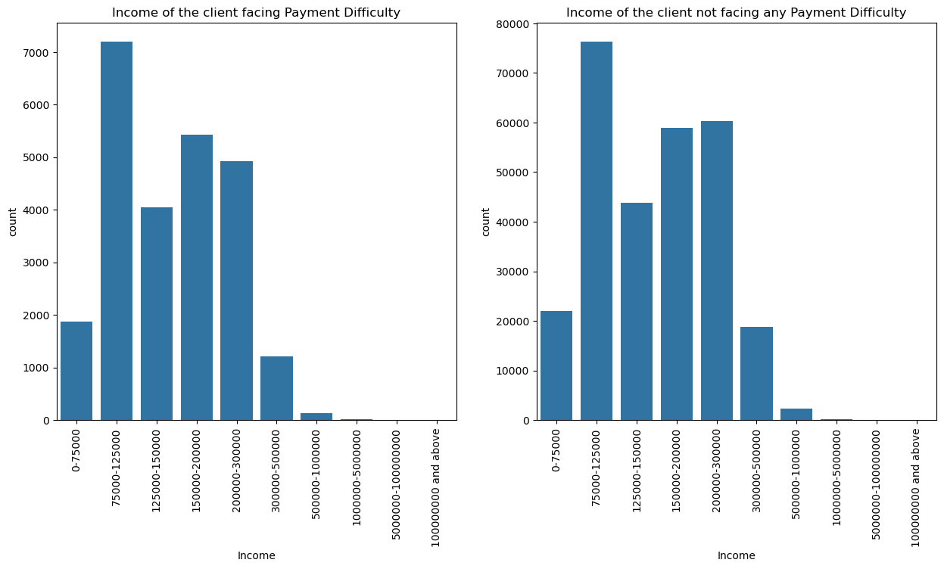
Clients with incomes of 75K to 300K are most likely to apply for the loan.

Slide 20
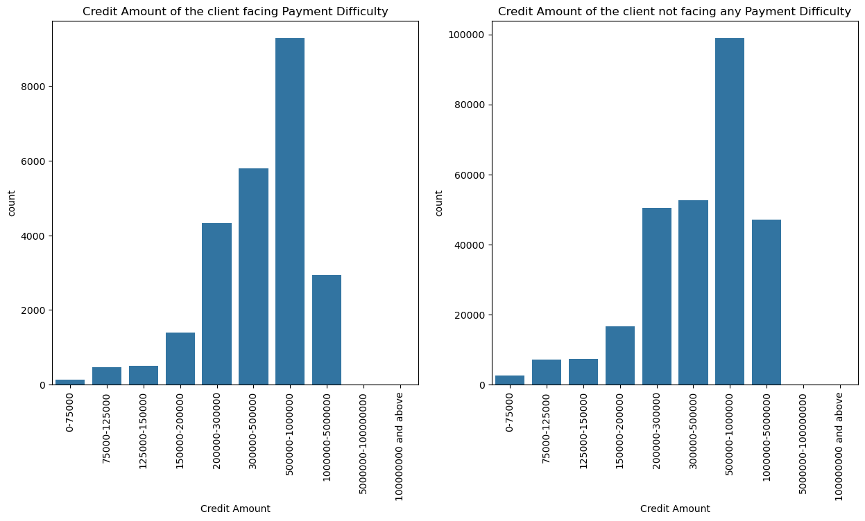

Slide 21
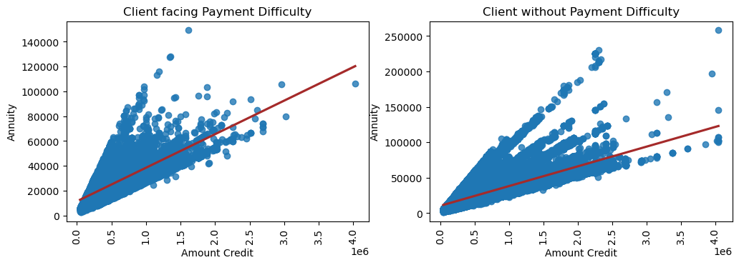
We have positive correlation between the Credit amount and annuity.

Slide 22
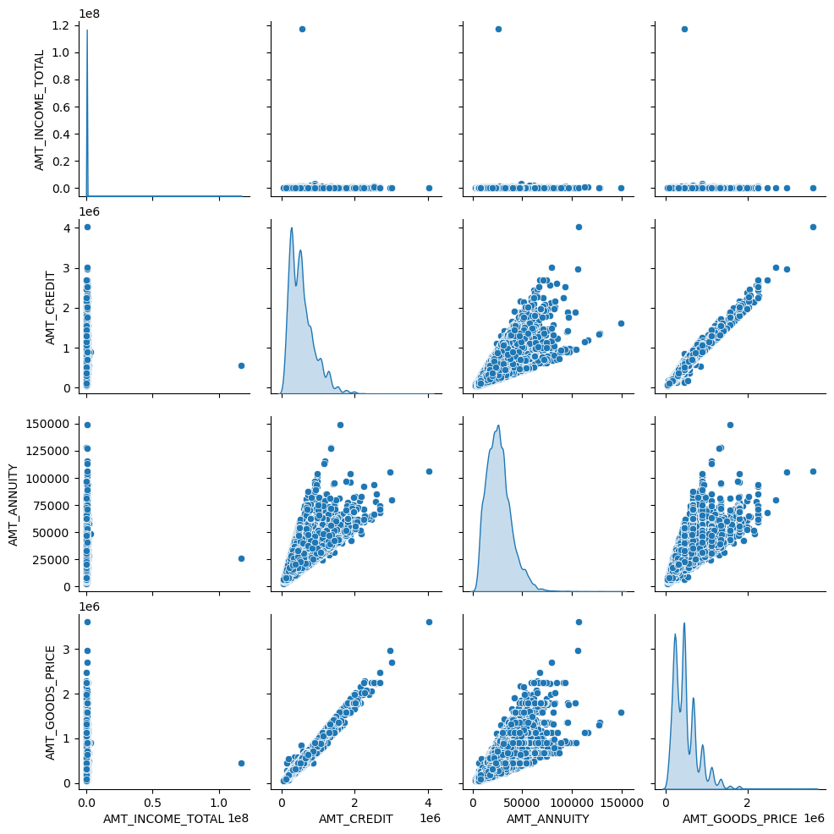

Slide 23
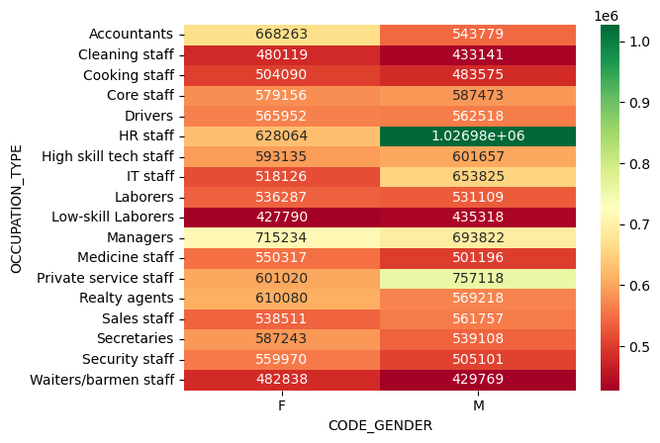
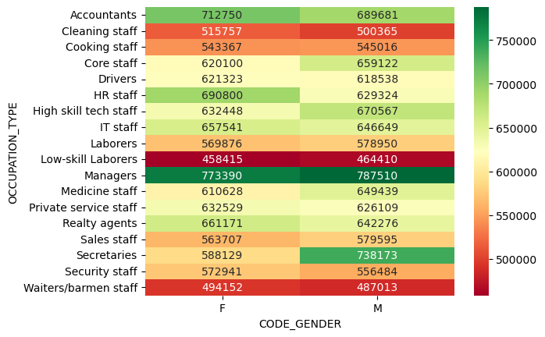
Male HR Staff have highest credit amount with no payment difficulties
Low skilled laborers has the least credit amount among the one with payment difficulties

Slide 24
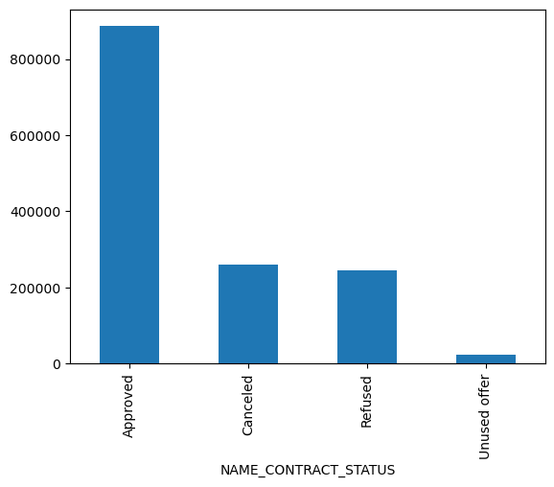
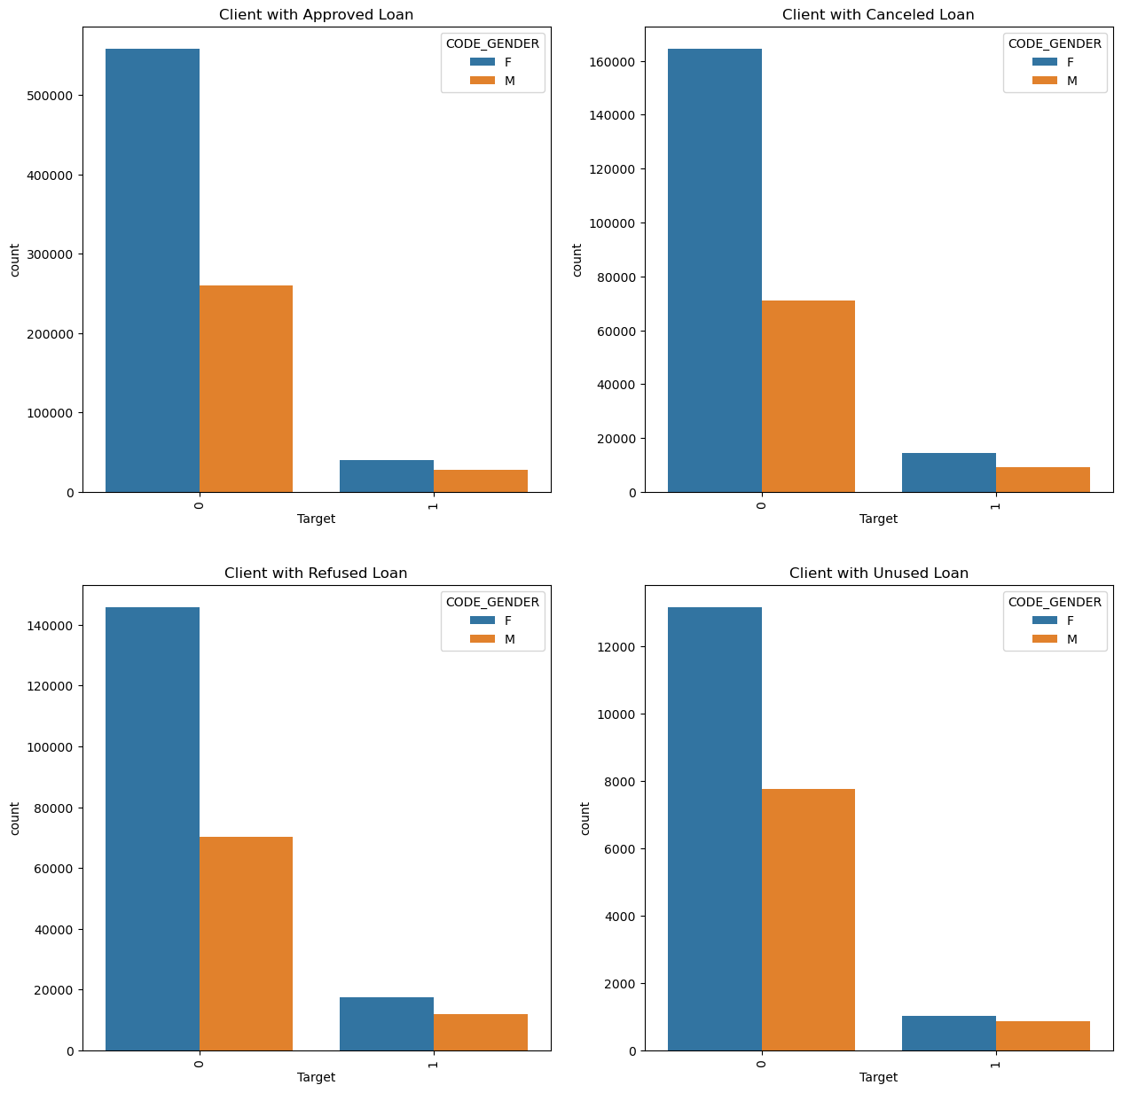

Slide 25
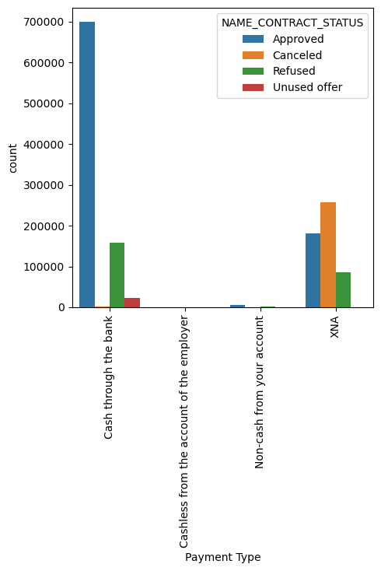
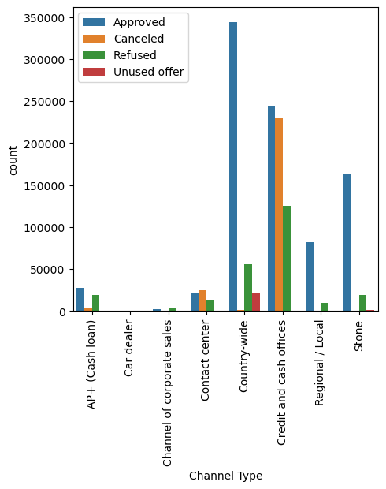
Most of the Applicant have opted to have Cash through the bank.
The Applicants were most bought through Credit and Cash Officers

Slide 26
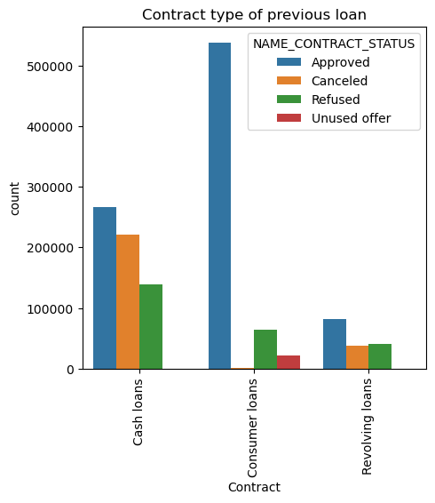
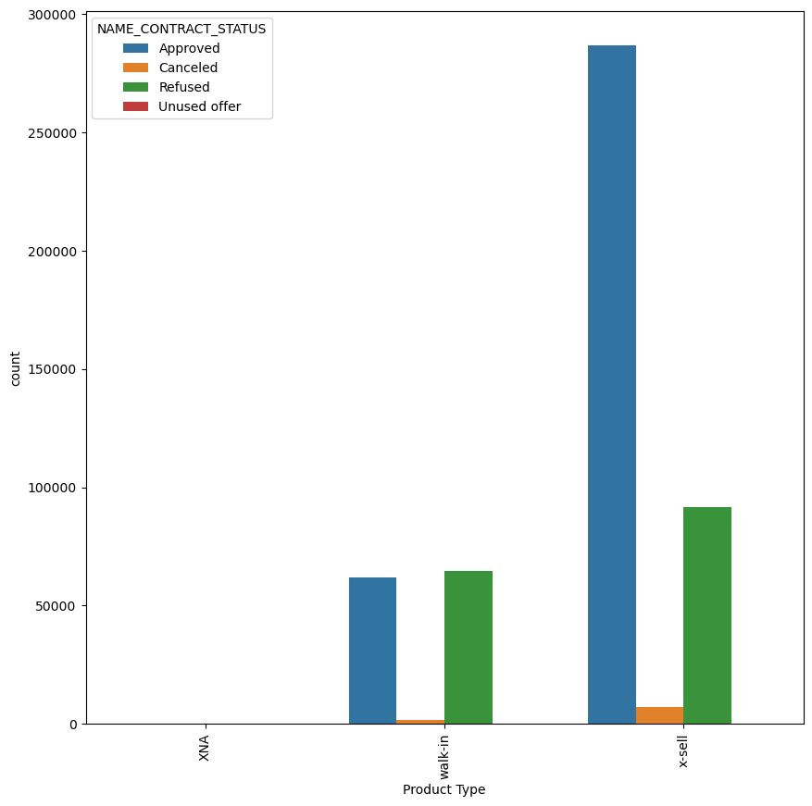
Most of the Approved applications are from consumer loan
And the X-sell is the main Product type.

Slide 27
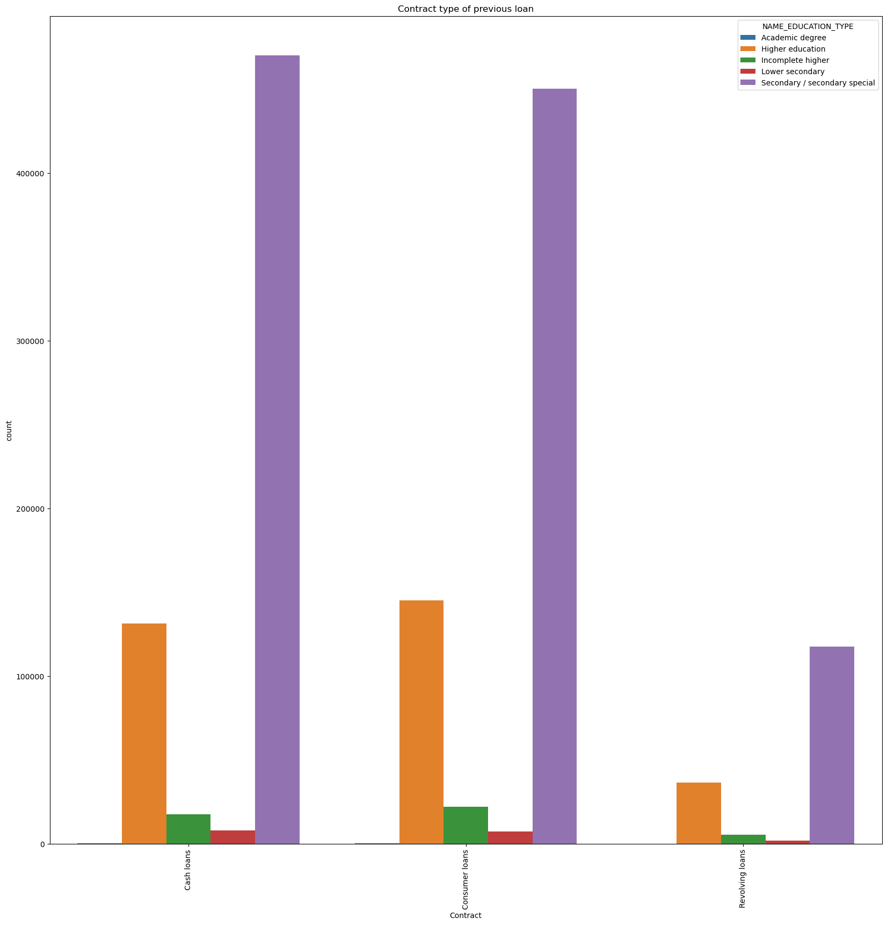
People with Academic degree prefer Cash and consumer loan, if in case bank try to target that group they will have to make the changes based on these things.

Slide 28
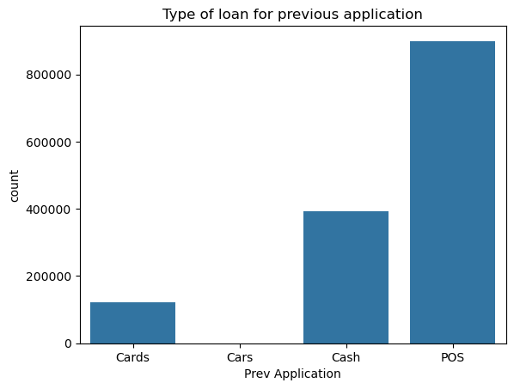
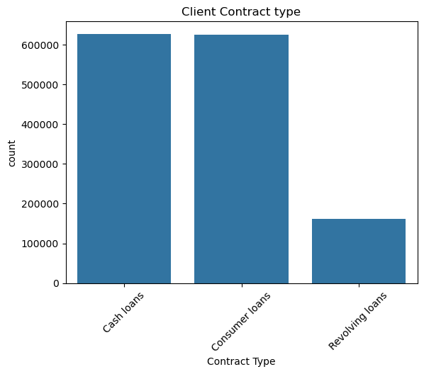
The previous loan Applicants opted for was for personal reason

Slide 29
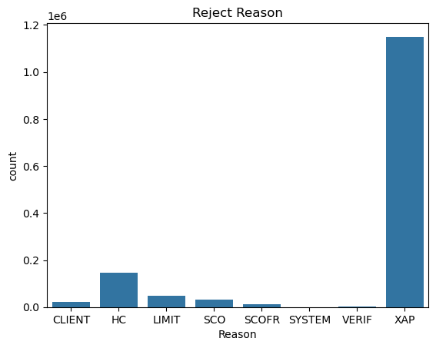
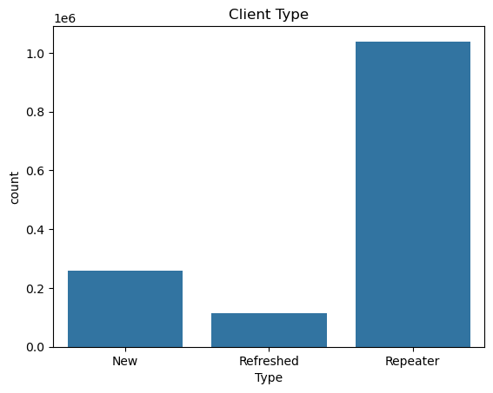
Most of the clients are Repeater
XAP is the most common reason for the rejection of the previous loan process.

Slide 30
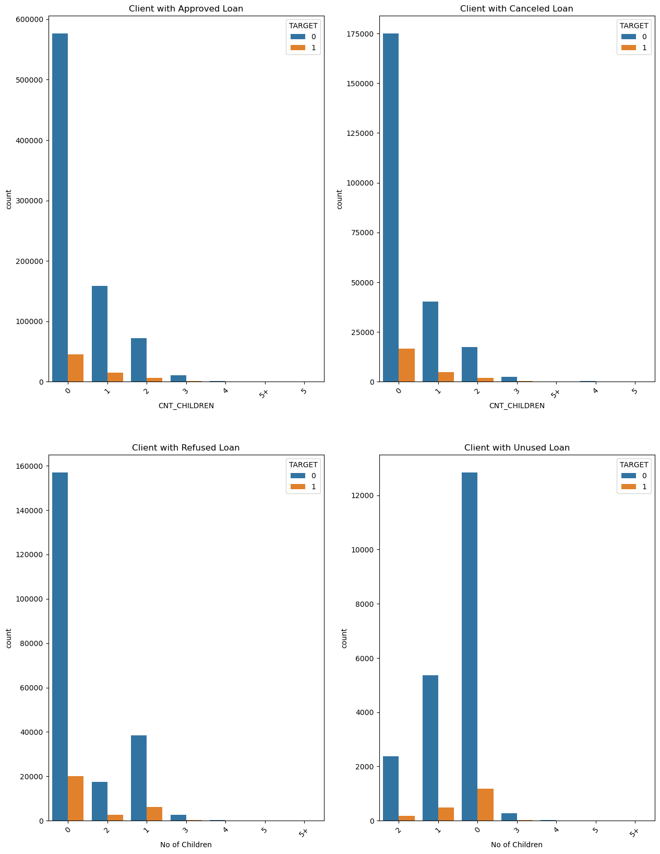

Slide 31
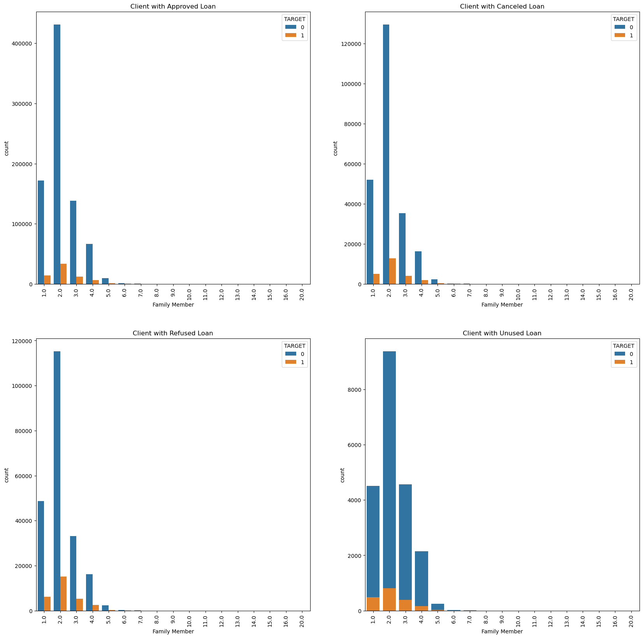

Slide 32
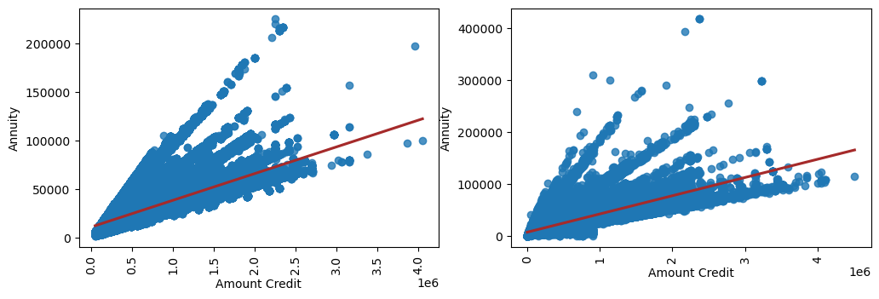

Slide 33
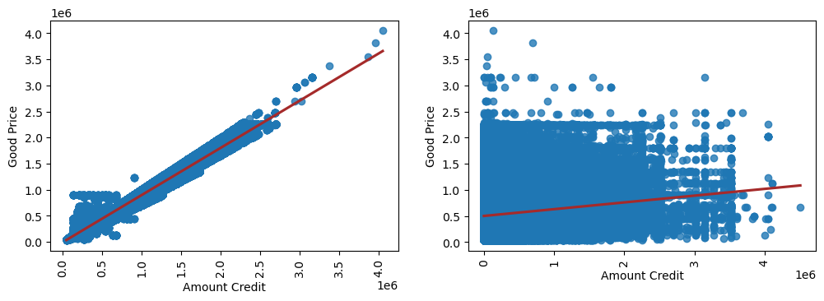

Slide 34

Summary

Slide 35
The data is Imbalance with 8% of records facing payment difficulties
Laborers faced the most difficulties while paying the loan credit
Most of the people preferred to have a cash loan rather than revolving loan
Females will mostly likely to reapply for the loan
The person who owns house faced more difficulties with the payment.
People with secondary Education are more likely to reapply, but Academic Degree has relatively almost no issue facing payment difficulties.
Married people are the one who applies more for the loan.
Most of the loan application got rejected at XAP
Clients preferred to opt in for Cash payment mode to pay the loan amount.
Most of the clients aged between 30 to 45.
DAYS_EMPLOYED & YEAR_EMPLOYED, DAYS_BIRTH & YEAR_BIRTH, DAYS_REGISTRATION & YEAR_REGISTRATION, DAYS_ID_PUBLISH & YEAR_ID_PUBLISH, and AMT_CREDIT & AMT_GOODSPRICE are correlated. If the other member increases, the pair will increase as well.
Loan acceptance rates are highest for families with up to three members.
A person with no more than two children is more likely to get their loan authorized.
The x-sell category was the preferred option.
Most applications are repeaters.
During the cross application processing (XAP), the majority of loan applications were refused.

Slide 36
CONCLUSION

Slide 37
Conclusion
Bank should start prioritize client retention by enhancing policies and tactics, as the majority of applicants are repeat customers.
They should also begin the Streamline XAP procedure, as the majority of loan applications were denied, which might result in greater acceptance rates and increased customer satisfaction.
Make cash loans more appealing and create more flexible payment choices.
They should target certain consumer demographics, primarily those aged 30 to 45, and offer greater customization options for loans. Professional graduates should also be targeted because they have a higher rate of loan approval.
The bank may consider providing financial education or support programs to assist customers who have payment challenges, such as laborers and homeowners.
The bank should priorities cross-selling additional products and services to existing customers, particularly those who already have a loan with them. This method can help the bank generate more revenue from existing customers.
Loans are more likely to be accepted for families with up to three people and no more than two children; banks might create focused marketing and financing packages for these households to enhance loan uptake.

Slide 38

Thank You
Arshad Shaikh
https://www.linkedin.com/in/arshad-shaikh1107/

